Slide 1
DON’T USE LARGE MINI-BATCHES, USE LOCAL SGD
ICLR
2020
Tao Lin
EPFL, Switzerland
Sebastian U. Stich
EPFL, Switzerland
Kumar Kshitij Patel
IIT Kanpur, India
Martin Jaggi
EPFL, Switzerland

Slide 2
Outline
Problem
Background
Motivation & Solution
Challenge
Technique
Evaluation
Conclusion

Slide 3
Problem
Models trained with large batches often do not generalize well, i.e. they do not show good accuracy on new data.

Slide 4
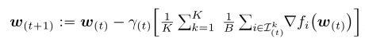
Background
Mini-batch SGD:
Local SGD: In local SGD, each worker k∈[K]s evolves a local model by performing H sequential SGD updates with mini-batch size B, before communication (synchronization by averaging) among the workers.
Large batch SGD: Recent schemes for scaling training to a large number of workers rely on standard mini-batch SGD with very large overall batch sizes, i.e. increasing the global batch size linearly with the number of workers K.

Slide 5
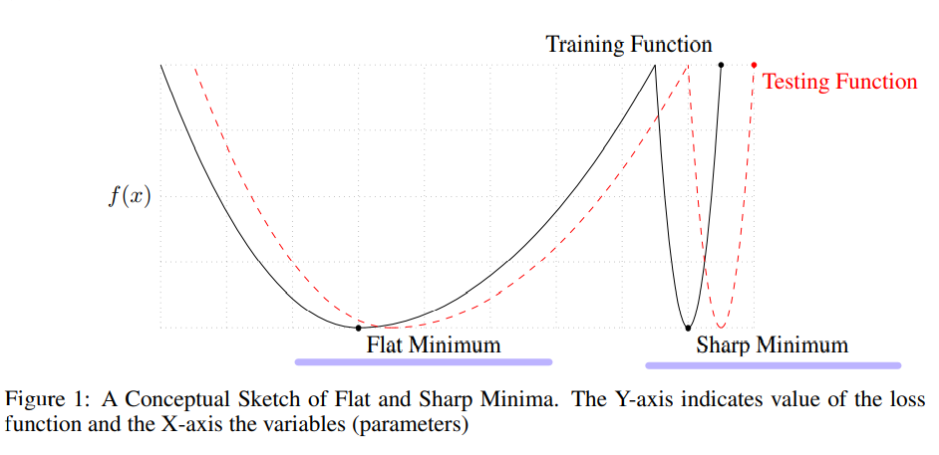
Background
Large batch SGD : Large-batch training makes better use of parallel computing. However, in practice, large-batch training has worse generalization, namely higher error on test dataset. (Generalization Gap)
Large-batch methods tend to converge to sharp minimum.
Small-batch methods converge to flat minimum
Generalization ability is negatively impacted by the training function at a sharp minimum.(MDL)

Slide 6
Motivation
Motivation
Address the current generalization issue of large-batch training
Challenge
Improves the generalization performance while enjoying the same efficiency (time-to-accuracy) and scalability.

Slide 7
Solution
Solution
post-local SGD, a simple but very efficient training scheme to address the current generalization issue of large-batch training.
Scale the training to much higher number of parallel devices.
Enjoy improved communication efficiency, while at the same time strongly outperforming most competing small and large batch baselines in terms of accuracy.
Reach flatter minima than large-batch SGD.

Slide 8
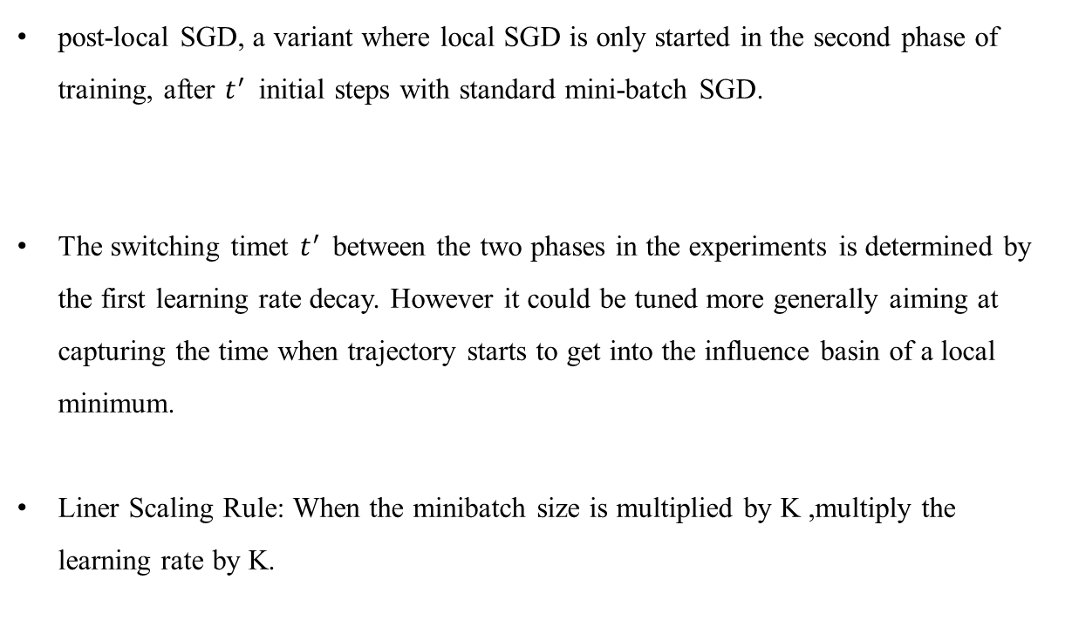
Technique
post-local SGD
post-local SGD, a variant where local SGD is only started in the second phase of training, after $t^{′ }$ initial steps with standard mini-batch SGD.
The switching timet $t^{′ }$between the two phases in the experiments is determined by the first learning rate decay. However it could be tuned more generally aiming at capturing the time when trajectory starts to get into the influence basin of a local minimum.
Liner Scaling Rule: When the minibatch size is multiplied by K ,multiply the learning rate by K.

Slide 9
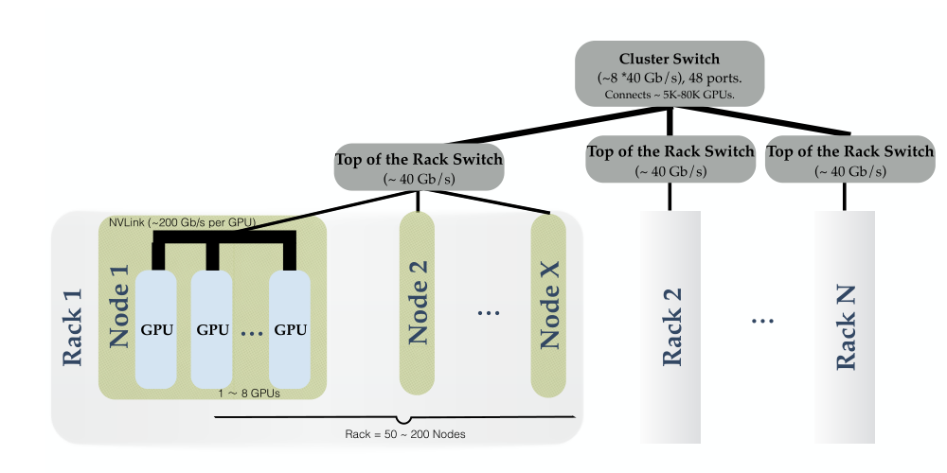
Technique
Hierarchical Local SGD: Optimal Use of Systems Resources in Heterogeneous Systems
Real world systems come with different communication bandwidths on several levels.
Such systems have become common in the industry, e.g. with GPUs or other accelerators grouped hierarchically within machines, racks or even at the level of several data-centers.

Slide 10
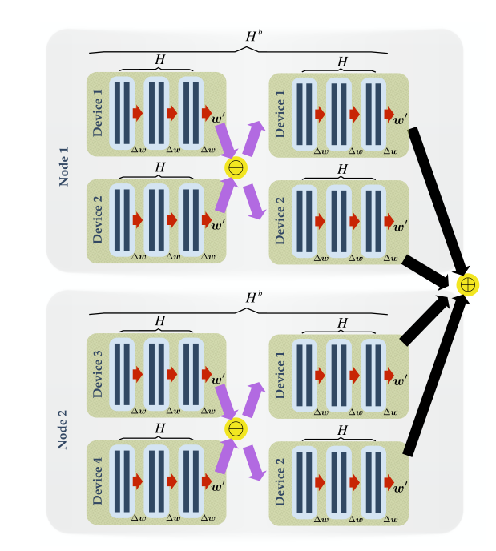
Technique
Hierarchical Local SGD: Optimal Use of Systems Resources in Heterogeneous Systems
Employ local SGD on each level of the hierarchy, adapted to each corresponding computation vs communication trade-off.

Slide 11
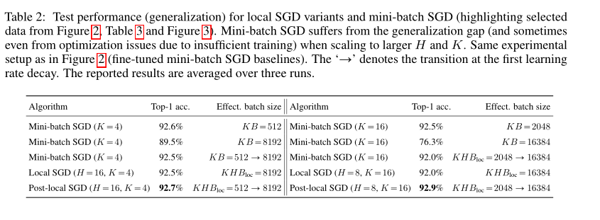
Evaluation
post-local SGD

Slide 12
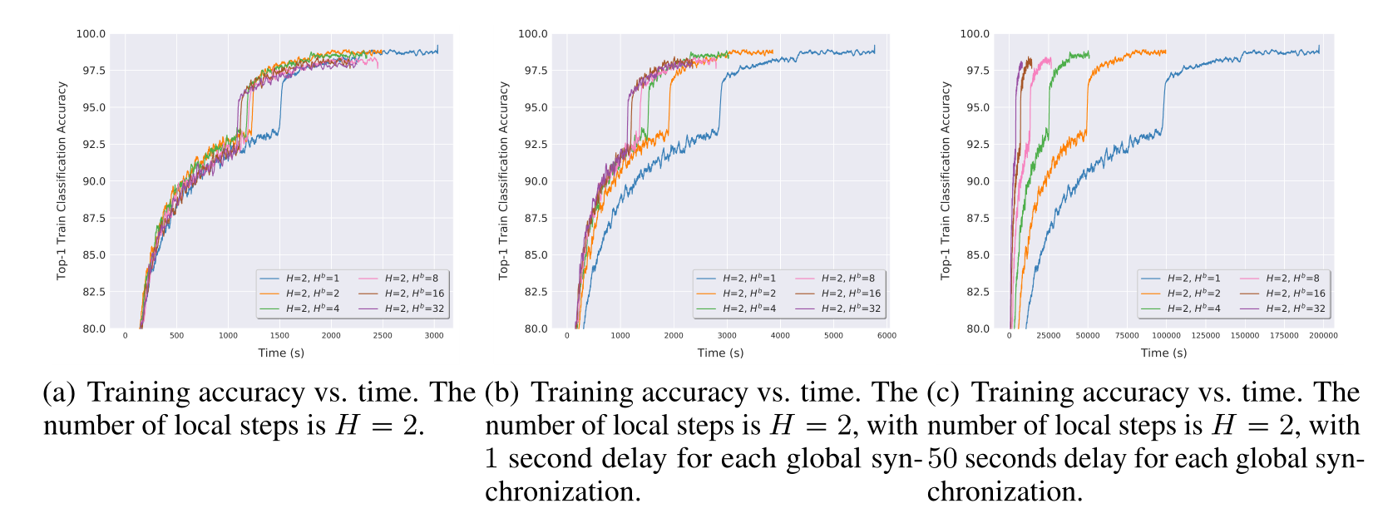
Evaluation
Hierarchical Local SGD:

Slide 13
Conclusion
This paper is the first work to extensively study the trade-off between communication efficiency and generalization performance of local SGD.
post-local SGD, not only outperforms large-batch SGD’s generalization performance but also matches that of small-batch SGD.
Hierarchical local SGD, showing its adaptivity to available system resources.

Slide 14

Q & A
Thank You!

